Slide 1
Session 7 EAFm cycle overview
Essential EAFm training
Date |Place

Slide 2
Session objectives
After this session you will be able to:
Describe the key steps of the EAFm cycle and how to plan, implement and monitor EAFm
Identify the planning steps in EAFm cycle
Describe the outline of an EAFm plan
Notes:
Self explanatory.

Slide 3
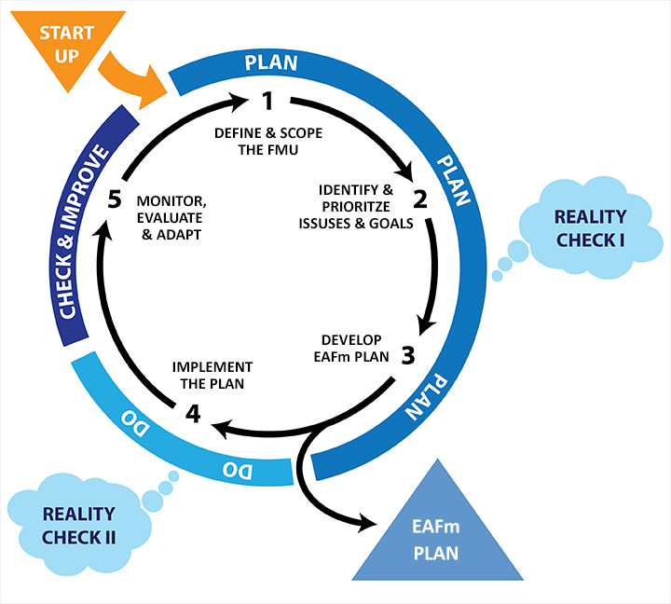
The 5 steps of EAFm
Notes:
This is first time the cycle visual is introduced in the course; it will be a recurring visual.
STRESS that this module gives a quick run through what we will cover over the week. Its like a snapshot without detail and needs to be run through quickly. Point to each element as you talk. Terms like FMU will be defined shortly.
[Some participants like to see the structure of the course, while others will be happy to skip this]
Refer to picture of this on wall-visual gallery (keep up as reference throughout course to remind participants of the steps through the cycle, so we can see every day how we are moving along).
There are 5 EAFm steps that fit under the general management cycle (outer circle).
Moving anti-clockwise around the cycle…….
The 5th step aligns with checking and improving
And the 4th step aligns with doing.
The planning phase into 3 steps; the output of these is an EAFm plan.
Before you start the process, you need to get organised and engage stakeholders – this is called STARTUP.
There are also 2 reality checks to make sure that we are being realistic and achievable.
See Participant Handbook Module 7, Figure 7.1.

Slide 4
Startup A
A: Prepare for EAFm
Decide on the general location for planning
Identify who should be involved
Plan for the process
Notes:
STARTUP A is getting organized and preparing the ground.
Many of the tasks in STARTUP A are only done once at the beginning of the process.

Slide 5
Startup B
B: Stakeholder engagement
Engage stakeholders for:
Participatory planning
Co-management
Notes:
In STARTUP B we engage the stakeholders.
The tasks in B are ONGOING: they are started here and continue throughout the lifetime of EAFm cycle.

Slide 6
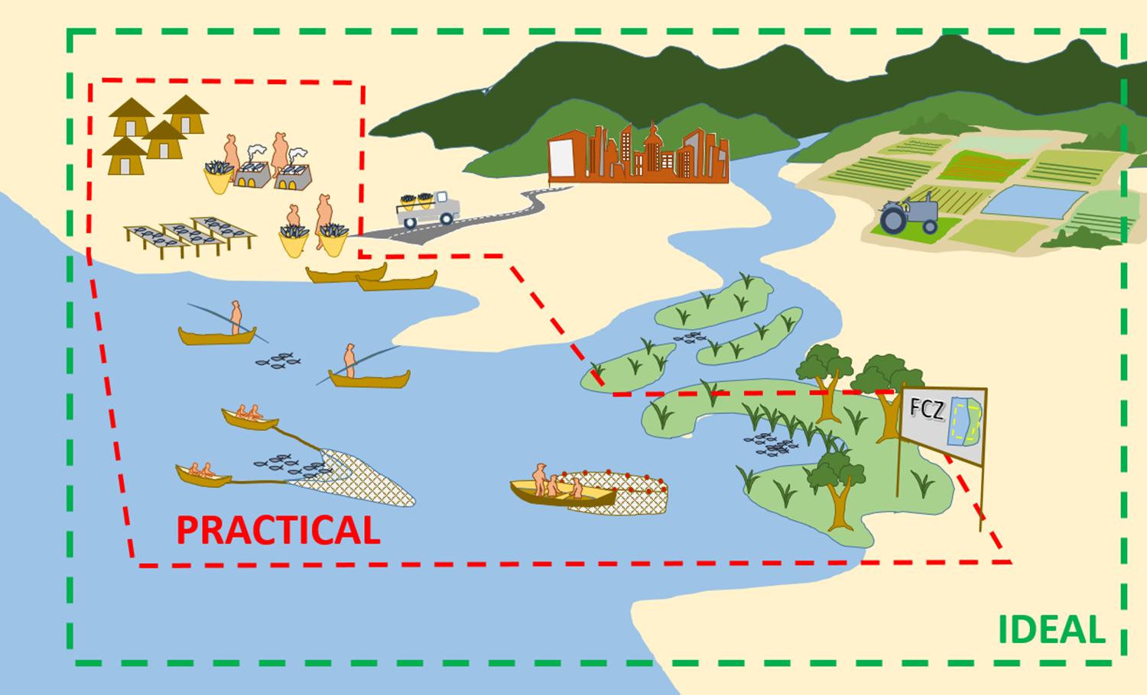
Step 1 Define and scope the Fisheries Management Unit (FMU)
1.1 Define the FMU
1.2 Agree the FMU vision
1.3 Scope the FMU
Provides background information and a vision
Notes:
Step 1 is called “Define and scope the Fisheries Management Unit”. In this step, stakeholders agree on a vision and pull together relevant background material.

Slide 7
Step 2 Identify & prioritize issues & goals
2.1 Identify threats & issues
2.2 Define goals for EAFm plan
2.3 Prioritize issues
Notes:
In Step 2, we firstly identify all the issues that affect the fishery and then we prioritise them. This allows us to set a number of goals about what we want to achieve in the longer term.

Slide 8
Reality check I
Reality check l
Constraints & opportunities
Facilitation / skills
Conflict management
Are the goals achievable?
Notes:
At this point we carry out a reality check to look at constraints and opportunities.

Slide 9
Step 3 Developing the EAFm plan
Develops the management framework
3.1 Develop management objectives
3.2 Develop indicators & benchmarks
3.3 Management actions & compliance
3.4 Identify sustainable financing
3.5 Finalize the EAFm plan
Notes:
In Step 3, the plan is developed based on the previous inputs from steps 1 and 2; and step 3 consist of no. of sub-steps.

Slide 10
EAFm plan template
EAFm Management Plan for FMU XX
Vision (Step 1)
Background (Step1)
Major threats and issues (Step 2)
Goals (Step 2)
Objectives, indicators and benchmarks (Step 3)
Management actions (Step 3)
Compliance (Step 3)
Data and info needs – source of data, etc. (Step 3)
Financing (Step 3)
Review of the plan – timetable for review
Notes:
In the planning steps we are developing an EAFm plan that has 10 headings. Each step in the EAFm cycle links to information to the plan.
See Participant Handbook Module 7, EAFm Plan template (last 2 pages of module).

Slide 11
Step 4 Implement
4.1 Formalize, communicate and engage
Implements the plan through formalizing and communicating it
Notes:
The plan needs to be formalized and communicated, or else it will be just another plan on some one’s desk. This is carried out in step 4 along with some considerations of how to implement it.

Slide 12
Reality check II
Reality check II
Governance
Co-management
Supportive environment
Checks whether the governance and supporting structures are in place
Notes:
In Reality Check II we check to see whether the governance and supporting structures are in place.

Slide 13
Step 5 Monitor, evaluate, adapt
5.1 Monitor & evaluate (M&E) performance of management
5.2 Adapt the plan based on M&E
Completes the EAFm cycle with M&E and adapts the plan to start a new cycle
Notes:
Step 5 is a critical, often forgotten stage. It is necessary to show you are on track, to help adapt the management properly, as well as to show results.
It needs to be planned, otherwise it will not happen.

Slide 14
Summary
Planning – Steps 1-3
Define & scope
Issues & goals
Objectives, indicators, management actions & compliance, financing
Doing - Step 4
4. Implement
Checking & improving - Step 5
5. Monitor, evaluate and adapt
Notes:
In summary – the EAFm cycle has 5 steps, 3 are planning, one is doing and one is checking and improving.
Refer back to session 6 just before this one where we agreed that we need PLANS to link (existing) policies to action (i.e. to be able to actually implement those policies).

Slide 15
Key messages
The EAFm cycle has 5 steps
Before the first step in the cycle, get organized in the Startup A and B
The EAFm plan is written from the outputs of Steps 1-3
In Step 4 the plan is implemented
In Step 5 the plan is evaluated and adapted for the next cycle
We do a reality check two times to make sure that we can really achieve the goals
Notes:
Self explanatory

Slide 16
Activity: The EAFm steps
Move to the large circle and follow instructions
Notes:
Activity to embed EAFm steps (see more details in Session Plan): After slide 14 (EAFm Plan template). All stand at back of room/ outside (need space for big circle). Trainer places large circle of string on the floor and 5 blank pieces of paper (representing EAFm cycle and 5 steps, but do not say this). Everyone stands in larger circle outside the string.
2. Trainer invites some participants (e.g. all those wearing glasses, wearing black shoes..) to stand in 1st place near/ on piece of paper. Ask: where are you now? (Elicit: step 1); what happens at this stage (i.e. define and scope FMU); what happened before (start up A+B). Repeat process for all 5 steps so by end everybody is standing at one of 5 steps, and all have experienced the EAFm cycle and reviewed what happens at each step.
3. Ask some questions to check all understand which of the 5 steps are planning, and which are other functions. Show of hands: Who is implementing? (should be only step 4), Who is doing M&E? (should be step 5), Who is planning? (should be steps 1-3). When does the EAFm plan get finalised (at end of Step 3). Where are the 2 Reality Checks? Which StartUp happens only once, and where? Have someone embody StartUp B and ask them to run round the circle of participants to illustrate that we start engaging stakeholders at the beginning and continue throughout the process.

Slide 17
Activity: Form working groups
Form working groups (may be based on shared fishery/shared geographical area)
You will work in these groups for much of the rest of the course, developing parts of the EAFm plan as you go through Steps 1–3
On Day 5, each group will present their draft EAFm plan and receive feedback
Notes:
See details in session plan for how to get groupings. We basically want groups that will be able to agree on a shared FMU, but we don’t actually say FMU here as we have not introduced this yet.
On the course there will be participants from natural clusters (i.e. from same fishery area) and these will probably be the FMU groups. If not, work with country groups and regional area groups.

